Slide 1
GITLAXT’AAMIKS VILLAGE GOVERNMENT POST-SECONDARY APPLICATION PROCESS
STEPS ON HOW TO COMPLETE THE APPLICATION FORMS & UNDERSTANDING OF THE POST-SECONDARY POLICY
2014

Slide 2
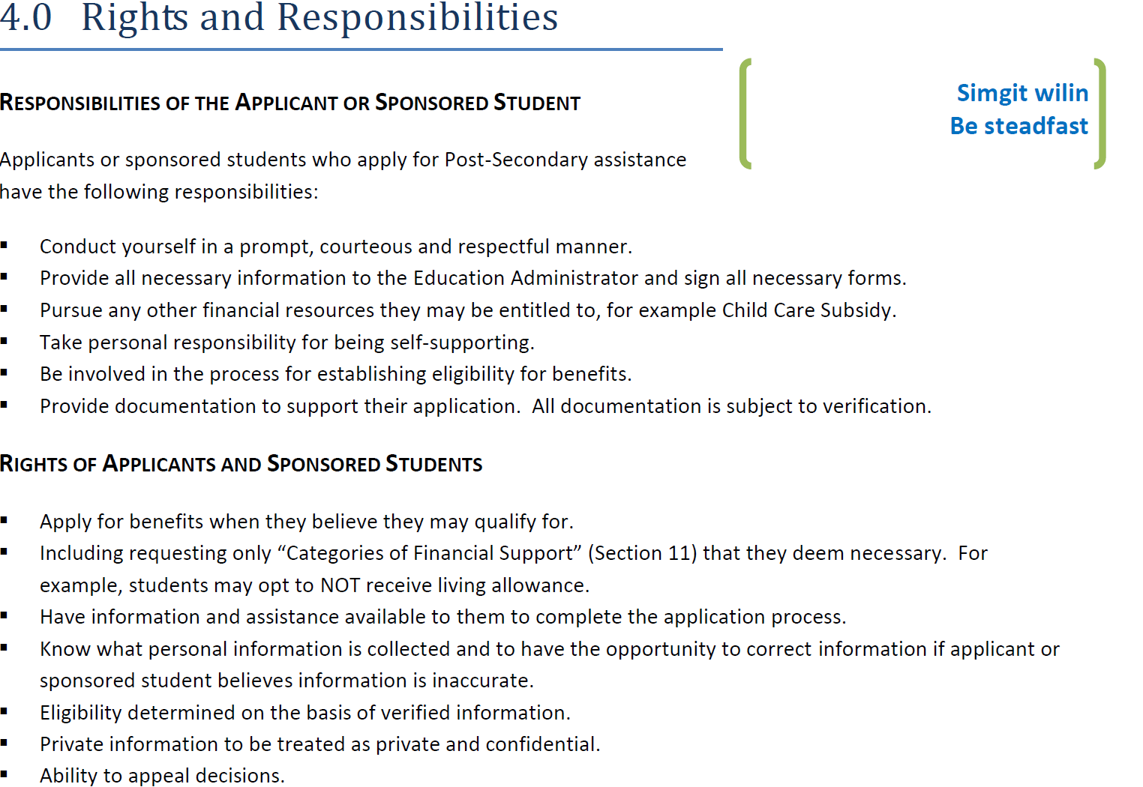
The understanding of the students rights and responsibilities: the required steps for completion of the application

Slide 4
For students to ensure that all supporting documents are submitted in a timely matter.
if a student is unable to contact the Post-Secondary Counselor, please ensure that you have a written letter for a family member to advocate on your behalf.
Without the written letter for an advocate we are unable to discuss any information as to your file, Gitlaxt’aamiks Village Government follows the privacy act for student confidentiality.
1st point of contact is Post-Secondary Counselor, 2nd point of contact is Education Administrator, 3rd point of contact is Programs & Services Director in the event that you need to report any information or concerns with your sponsorship.

Slide 5
This is where the Post-secondary counselor steps away from their position and the education administrator takes the role as post-secondary counselor

Slide 6
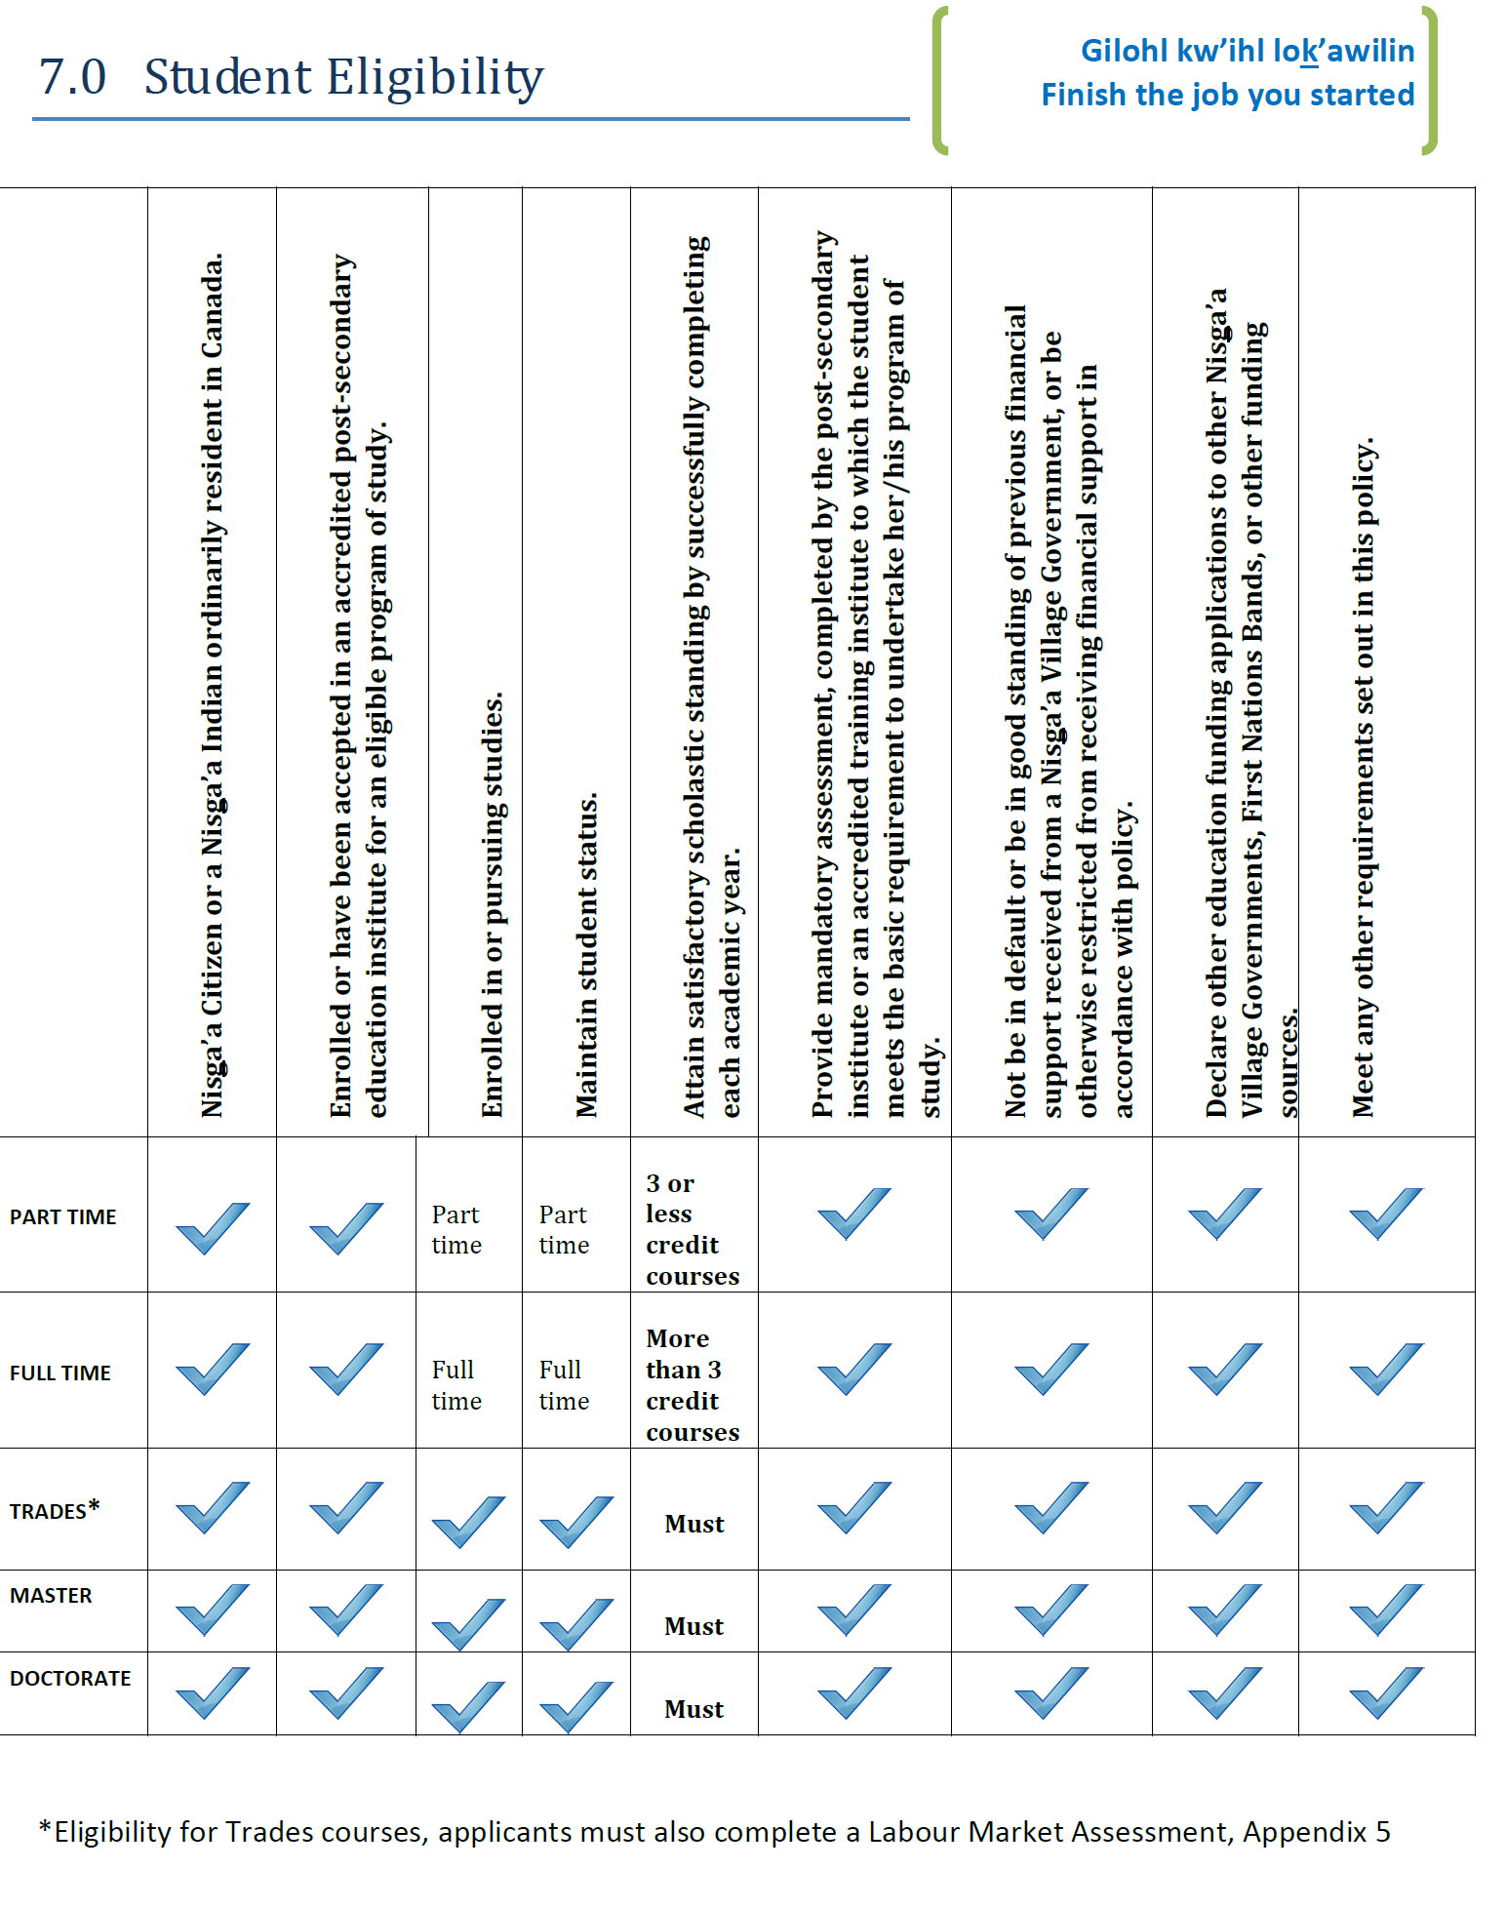

Slide 8
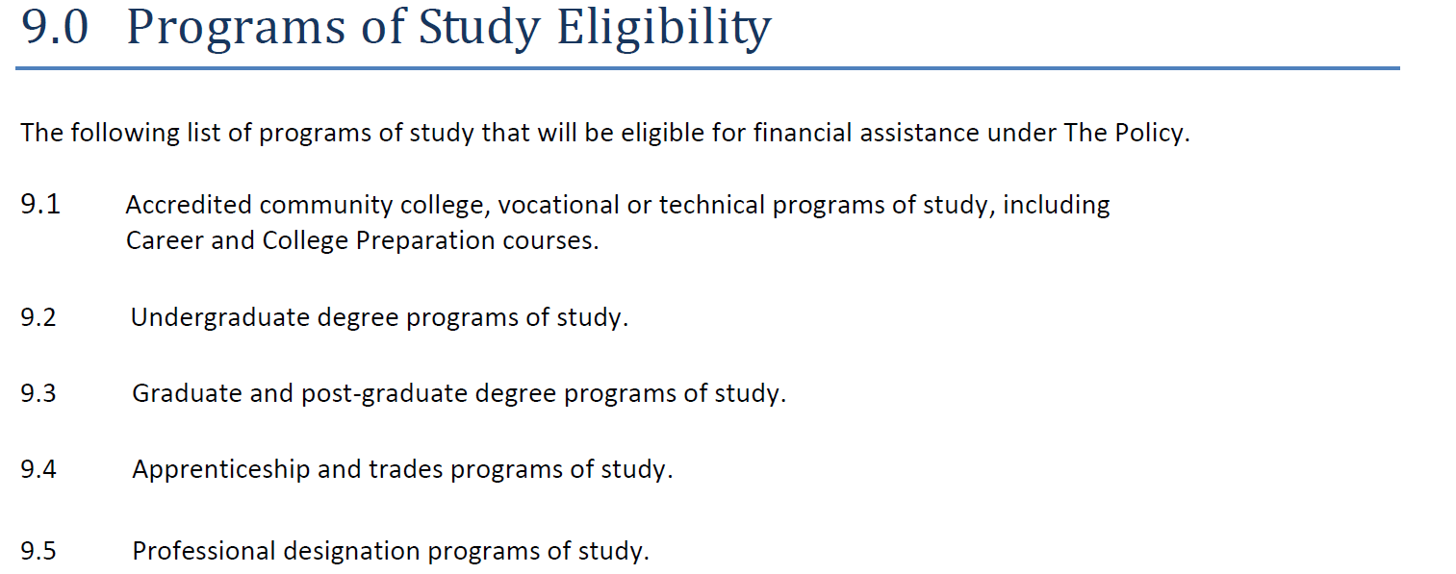

Slide 9
PLEASE ENSURE THAT ALL SUPPORTING DOCUMENTS ARE SUBMITTED WITH YOUR APPLICATION, INCLUDING YOUR BANKING INFORMATION TO ENSURE THAT THIS WILL NOT DELAY THE PROCESS OF YOUR FUNDING BASED ON APPROVAL.

Slide 10
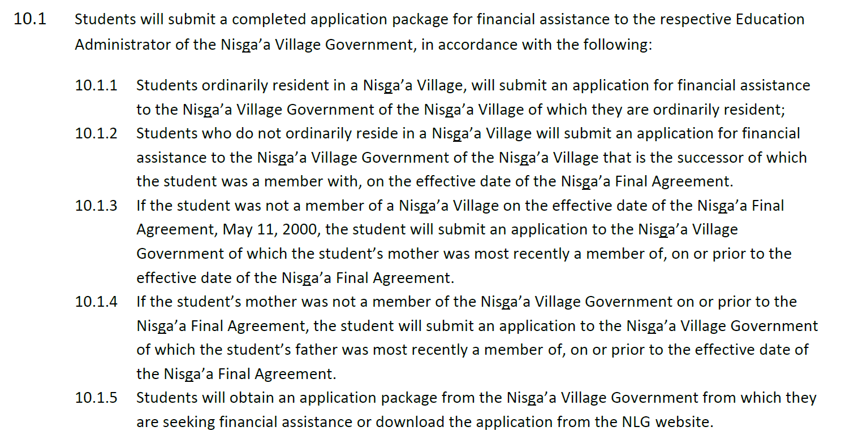

Slide 11
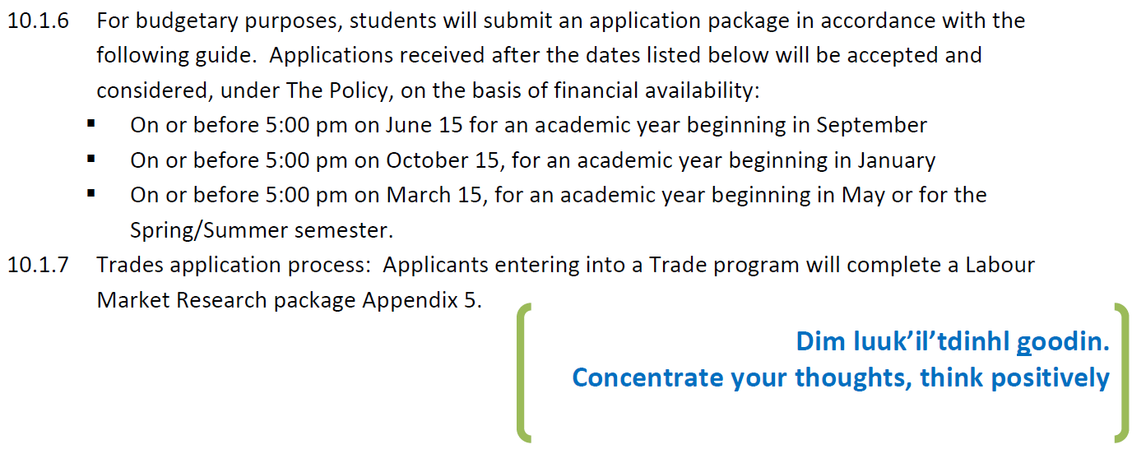
Gitlaxt’aamiks Village Government Post-Secondary Department will accept funding applications on or before 5:00 pm June 15th of each year

Slide 12
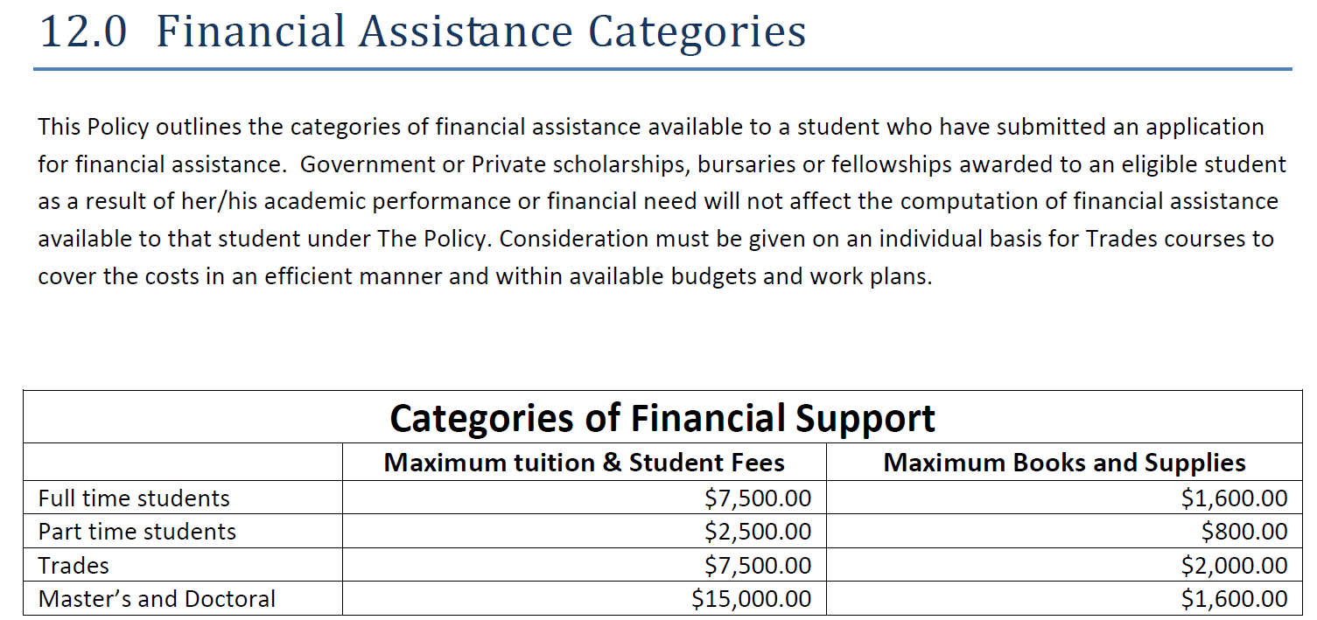
APPLICATIONS FOR MASTER’S AND DOCTORAL PROGRAMS WILL BE BASED ON AVAILABILITY OF FUNDS

Slide 13
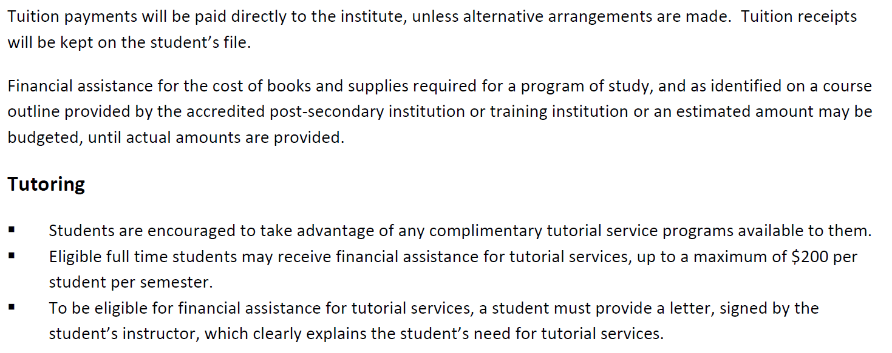
TUITION AND BOOKS/SUPPLIES WILL BE ADMINISTERED DIRECTLY TO THE APPLICANT, UPON APPROVAL OF SPONSORSHIP.

Slide 14
PLEASE ENSURE THAT YOU PROVIDE YOUR TAX FORMS WITH YOUR APPLICATION AS WE NEED TO DETERMINE THE LEVEL OF ELIGIBILITY YOU WILL RECEIVE.

Slide 15
A WRITTEN LETTER TO REQUEST TRAVEL FOR STUDENTS MOVING FROM DESIGNATED RESIDENCE TO WHERE THEY ARE ATTENDING POST-SECONDARY THAT IS 600KM OR MORE FROM THEIR PLACE OF ORDINARY RESIDENCE.

Slide 16
FOR MEDICAL LEAVES, PLEASE ENSURE THAT ALL SUPPORTING DOCUMENTS (i.e. letter from the doctor and confirmation letter from the institution is included)when submitting to the Post-Secondary Counselor

Slide 17
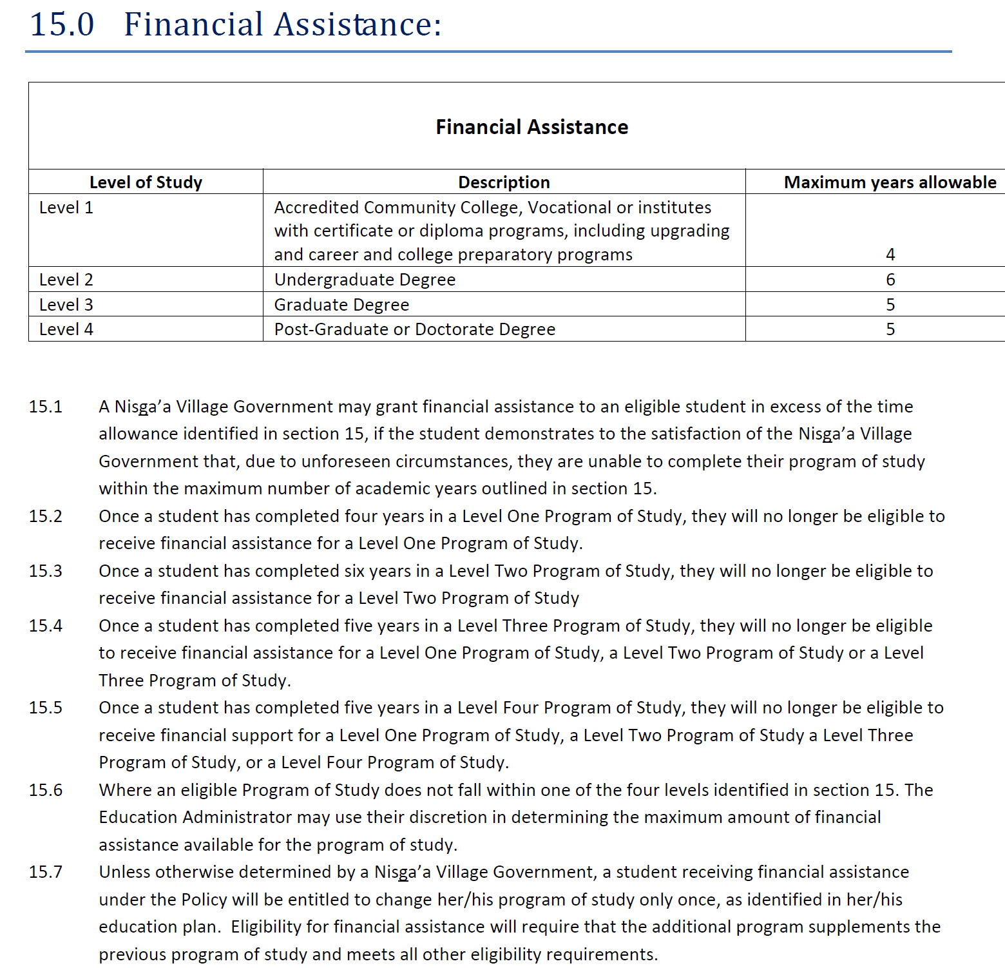

Slide 18
UPON SUCCESSFUL COMPLETION OF YOUR PROGRAM, APPLICANTS CAN APPLY FOR THE INCENTIVE GRANT, PLEASE ENSURE THAT YOU HAVE WITH YOUR WRITTEN LETTER REQUESTING THE INCENTIVE GRANT THAT YOU ALSO INCLUDE YOUR MOST RECENT OFFICIAL TRANSCRIPT.

Slide 19
AS PART OF THE AGREEMENT SIGNED BETWEEN THE STUDENT AND Post-secondary counselor, once you have completed each year of your studies to ensure that you provide your official transcript to complete your sponsorship year. Note that in between semesters you are also required to submit a transcript for the post-secondary counselor to see that you are maintaining your Grade Point Average

Slide 20
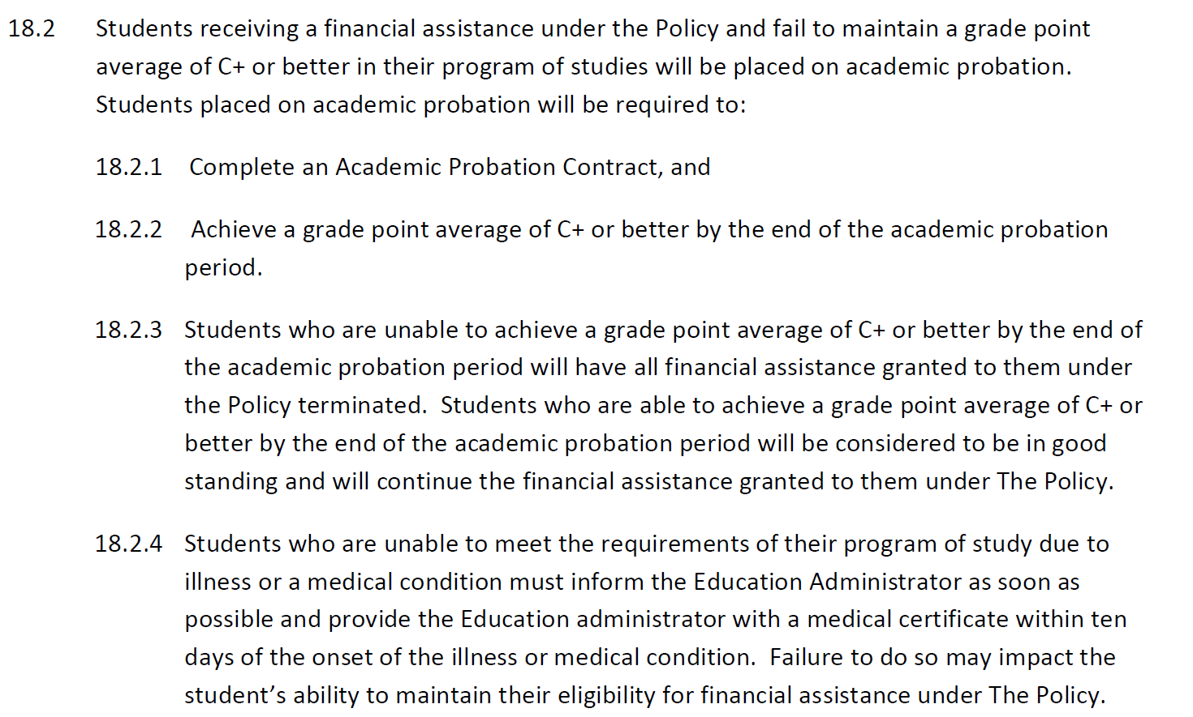

Slide 21
Please review carefully 19.0 of the post-secondary policy to ensure your sponsorship status

Slide 22
Part 2. of 19.0

Slide 23
The applicant can request for an application to appeal the decision of the post-secondary counselor. The application is submitted to the director/education administrator of the village government the applicant applied to and the response to the decision is within 7 days of submitting the appeal.

Slide 24
Please ensure that all required documents are submitted with your application for review.

Slide 25
If you are unable to fulfill your programs from 4 or 5 programs, you must immediately contact the Post-Secondary Counselor or Education Administrator of Gitlaxt’aamiks
1. if your programs are too heavy of a course load..ie first year students or students who are were on medical leave.
2. first year students mainly grade 12 are advised to take no more than 3 course per semester for the first year and then increase to 4 courses in the second year of sponsorship.
3. students on medical leave and return back to school, must provide the Post-Secondary Counselor or Education Administrator a copy of your medical clearance.
4. please ensure to read your Post-Secondary Policy, this is your guiding tool to your future sponsorship.

